Slide 1
Real Accountability

Slide 2
Agenda
1
Define Accountability
2
Design Metrics
3
Construct Reports
4
Prepare Weekly Meeting Agenda

Slide 3
Learning Objectives
Define what real accountability is and isn’t
Define current misunderstandings of accountability
Define and understand how these misunderstandings lead to significant breakdowns in performance, productivity, and profits
Identify examples of industry accountabilities
Have accountabilities designed to hold every single task

Slide 4
7 Steps to Power Academy
Key Terms
Accountability – the opportunity to report – to account, to say.
Responsibility – the opportunity to respond.
Ownership – being responsible for the result. Taking Ownership means doing whatever needs to be done to produce the result or outcome.
Discretionary Effort – is the level of effort people give of their
own free will, without being managed?

Slide 5
7 Steps to Power Academy
Define Accountability
Accountability: as defined by Webster’s
A statement or record of financial transaction
To give an explanation for
Answerability; Answerableness
To be called to account for
Being obliged to answer to someone else for your actions
To hold accountable for
To consider responsible and answerable
To be the cause or source of

Slide 6
7 Steps to Power Academy
Define Accountability
Responsibility: as defined by Webster’s
The quality or state of being responsible
Moral, legal, or mental accountability
Reliability, trustworthiness
Something for which one is responsible

Slide 7
7 Steps to Power Academy
Define Accountability
Ownership: as defined by Webster’s
The state, relation, or fact of being an owner
The state or fact of owning something
A group or organization of owners

Slide 8
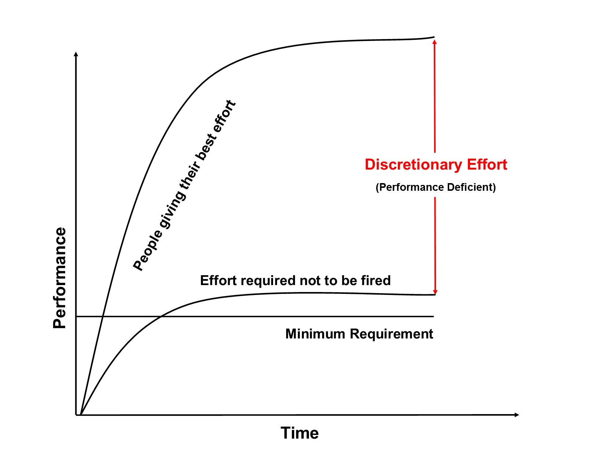
7 Steps to Power Academy
Define Accountability
Discretionary Effort Defined

Slide 9
7 Steps to Power Academy
Real Accountability - Defined
The Promise of This Course…
(The Breakthrough):
We will learn how to use Real Accountability as a tool to move from control towards
Freedom Based Management.
The result being a work force that is unleashed and highly productive.

Slide 10
7 Steps to Power Academy
Real Accountability - Defined
Accountability, Real Accountability is a personal choice.
You can’t make that choice for another.

Slide 11
Real Accountability - Defined
People are more empowered with what they say
rather than what YOU say.
What you say may not even get heard, maybe only 20%.
Their own speaking brings retention up to 80%.
Speaking for themselves builds their sense of self confidence and
Self-expression, STRENGTHENING who they are as a team member.
People are at their BEST when they have been given
the POWER to make work happen.

Slide 12
Real Accountability - Defined
REAL ACCOUNTABILITY starts with asking someone
what their Accountabilities are.
Have your teams work together to choose the Accountabilities that work best
for each INDIVIDUAL and TEAM and the business.
Well-designed Accountabilities encompass ALL tasks, and support
the work we’re doing later towards metrics, reporting, and ownership.

Slide 13
Real Accountability - Defined
Real Accountability is consistent with the Human Spirit.
Empowered employees have these attributes:
A strong work ethic.
The state or fact of owning something.
Derive a great deal of satisfaction from getting the job done.
Experience accountability as an empowerment to their success.
Get energy from challenges and accomplishments.

Slide 14
Real Accountability - Defined
Any task not being held by someone will likely be a problem;
businesses typically suffer when there are tasks NOT being held
inside someone's ACCOUNTABILITIES.
Every person may have several Accountabilities
under which every TASK they perform FALLS.

Slide 15
7 Steps to Power Academy
Real Accountability - Misunderstandings
What’s the problem?
We have a fundamental misunderstanding of what
Real Accountability is.
Our historical practice is command and control,
which creates a parent-child relationship that is NOT empowering.
And then we wonder why employee engagement
in the U.S. is hovering at 32%.

Slide 16
7 Steps to Power Academy
Real Accountability - Misunderstandings
Wow!
Let that sink in. . .
People doing only 32% of what they are really capable of.

Slide 17
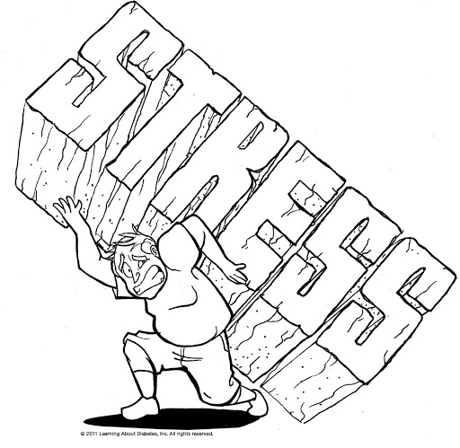
7 Steps to Power Academy
Real Accountability - Misunderstandings
Then what happens???
Owners get concerned to say the least, or just plain freak out, pushing, micro-managing, controlling, hovering, or just shoving people out of the way and taking over to do everything themselves.
All of which creates a STRESS CYCLE
(more on this later)

Slide 18
7 Steps to Power Academy
Real Accountability - Misunderstandings
Often, Control and Real Accountability get confused;
Control or fear-based management always demotivates employees.
Then leaders get busy trying to fix problems as they arise not realizing
their own management style is the SOURCE of the problem.

Slide 19
7 Steps to Power Academy
Real Accountability - Misunderstandings
Where a lot of leaders get into TROUBLE and
go down the WRONG TRACK
is thinking they have offered someone a
CHOICE
to buy in when in fact they have not.

Slide 20
7 Steps to Power Academy
Real Accountability - Misunderstandings
What they are doing is assigning something to them.
The result being…the employee feels DOMINATED.
This leads to a lack of buy in and motivation, and results in
leaders working way too hard to drive things, frustration and stress builds up,
and eventually it all leads to owners and leaders feeling
EXHAUSTED. (And the stress cycle repeats)
As we said earlier, discretionary effort is at 32% in the U.S.
That means people are on cruise control, their
engagement is just enough to get PAID.

Slide 21
7 Steps to Power Academy
Real Accountability - Misunderstandings
What about money?
Doesn’t that work?
Don’t people get motivated by money?
Numerous studies from top tier economists at MIT, Carnegie Mellon, and University of Chicago, in addition to years of study by
psychologists, and sociologists all AGREE…

Slide 22
7 Steps to Power Academy
Real Accountability - Misunderstandings
Money motivates. . . if
the task is simple, very simple,
and involves the use of mechanical skills.
Once the task requires higher cognitive skills,
cash rewards produce poorer performance.

Slide 23
7 Steps to Power Academy
Real Accountability - Misunderstandings
Higher cognitive skills?
You mean like what you are asking of Estimators and Project Managers?
Yes! That's exactly what I mean.
So…how does this work?

Slide 24
Real Accountability - Misunderstandings
What works is to PAY people enough money
to take the issue of MONEY off the table.
When they aren’t thinking about the MONEY,
they are FREED up to think about their WORK.
That's what YOU want your entire business culture to support.

Slide 25
Real Accountability - Misunderstandings
What About Job Descriptions vs. Accountabilities
Yes, job descriptions are useful to a point, but limited.
Useful in that they serve to clarify what there is to do.
Not useful in that a job description can never entirely define the entirety of all the actions to be done.
The result being something always slips through the cracks.

Slide 26
7 Steps to Power Academy
Real Accountability - Misunderstandings
Job Descriptions vs. Accountabilities
The problem here is people might tend to only do what the job description says.
Task orientated job descriptions say EXACTLY what people should do.
Accountability SUPPORTS the desired outcomes.
Accountabilities are unlimited, i.e. BEING ACCOUNTABLE for sales
means you do whatever it takes to have sales.
Wouldn’t you prefer to have both?

Slide 27
7 Steps to Power Academy
Real Accountability - Misunderstandings
But, what if…
What if a key employee doesn’t want to choose their Accountabilities?
Not to worry, I have never seen that happen. But even if it did…
Wouldn’t you like to know today rather than somewhere
down the road that there's a problem with someone NOT choosing
what they are to be ACCOUNTABLE for?

Slide 28
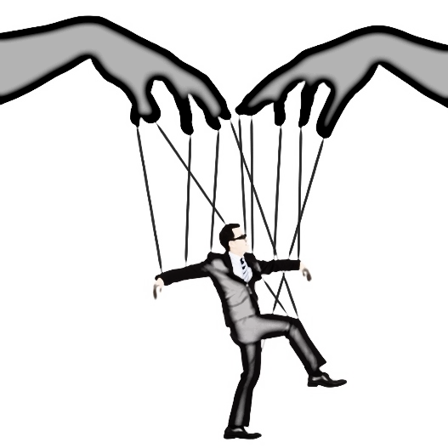
Real Accountability - Breakdowns
Breakdowns
If your management style is command and control,
DON’T be surprised that it produces institutionalized
parent-child behavior that is now dependent on your continued
hand-holding micro-management.
A top down management style will rob teams of the opportunity for
CRITICAL THINKING – a necessary component for
OWNERSHIP and PRODUCTIVITY.

Slide 29
Real Accountability - Breakdowns
That looks like:
Customers don’t get called back
Documentation and job notes don't get updated
Jobs don’t get scheduled out
Which results in:
Missed timelines and closed work getting pushed out
Margins slipping below profitable goals
Upset customers losing trust and not paying

Slide 30
Real Accountability - Breakdowns
Which means:
Managers / Key Employees get stressed, work harder, longer hours
Impacting their ability to manage their teams as effectively
This causes:
Employees to be left confused or feel that they cannot ask for help in fear of stressing their boss out more.
This leads to more job mistakes, miscommunications, and missed deadlines.
And now were back to square one, except now Everybody is stressed

Slide 31
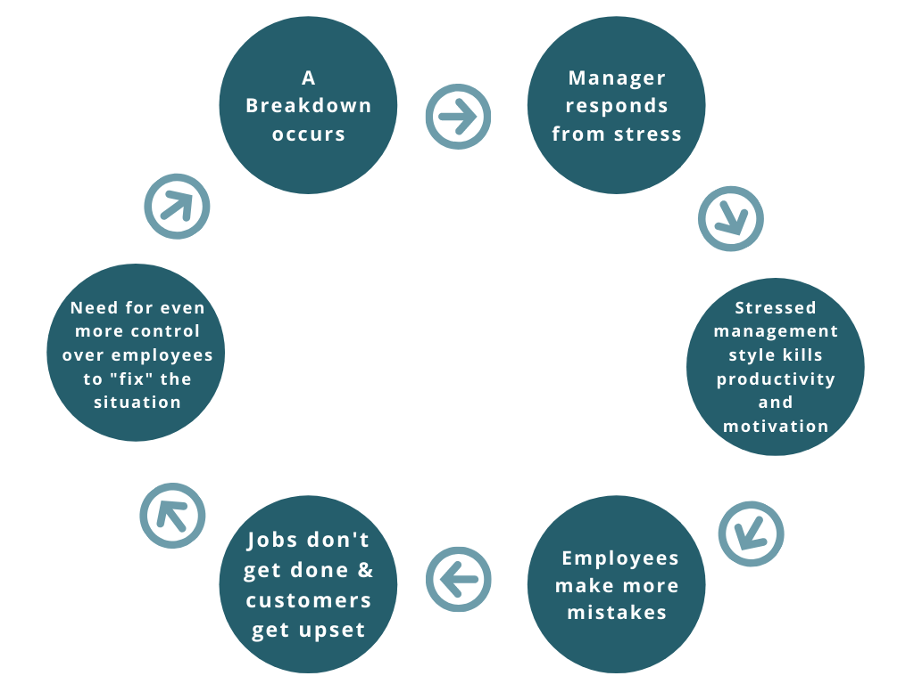
Real Accountability - Breakdowns
Stress Cycle:

Slide 32
Real Accountability - Breakdowns
Now you understand why employee engagement in the US is only 32%
Again….that means people are doing just enough to keep the ship afloat versus leading it confidently into battle

Slide 33
Real Accountability - Breakthroughs
Here’s the Good News:
There is still 68% left on the table!
What would happen in your company if you only captured 50% of that productivity?
What would that mean in terms of your GROSS PROFIT and NET
if your employee’s productivity only went up 34%?

Slide 34
Real Accountability – Breakthroughs
Three Factors of Real Accountability that lead to a business culture of performance, productivity and profitability:
Autonomy – FREEDOM to be self-directed
Mastery – OPPORTUNITY for continuous learning
Purpose – KNOWING that what you are doing is making a difference

Slide 35
7 Steps to Power Academy
Real Accountability - Breakthroughs
Your Business Culture
Culture is defined as what your employees do when you are NOT telling
them what to do.
Your Culture is made from the systems, practices, and behaviors you employ.
That is what acts on and impacts their behaviors every HOUR of the day.
Real Accountability is Ownership…it is a practice and behavior of being responsible for what happens NOW, today, and in the future, there is no waiting to see how it all turns out later.

Slide 36
7 Steps to Power Academy
Real Accountability - Breakthrough
We know from decades of study from numerous institutions
that people give their BEST effort,
are the most CREATIVE,
and are the most in ACTION when they feel
like they have a VOICE,
are making a difference, and have the freedom
to THINK for themselves.

Slide 37
7 Steps to Power Academy
Real Accountability - Breakthroughs
Freedom Based Management
Unleashes individual performance
Adds acceleration to their performance
Turns teams into the driving force of the business

Slide 38
7 Steps to Power Academy
Real Accountability - Breakthroughs
REAL ACCOUNTABILITY as a Freedom-Based choice means…
Each individual has the FREEDOM to CHOOSE on
their OWN what their ACCOUNTABILITIES are.

Slide 39
Real Accountability - Breakthroughs
Your employees will play any GAME you set up.
It is your job as a LEADER to set up a game, so everyone wins.
As you LEAD, so they follow.
Now you have the foundation for a game where everyone can WIN!

Slide 40
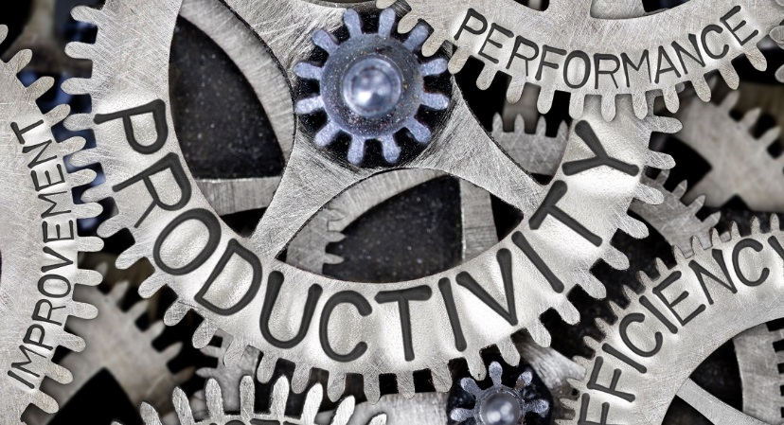
7 Steps to Power Academy
Real Accountability - Success Stories
Examples of people working for FREE to have the experience of CHALLENGE, MASTERY, and PURPOSE:
Linux, Apache, Open Source, Wikipedia

Slide 41
Real Accountability Review

Slide 42
Key Points
1
Every task performed is held within someone’s accountability.
Group discussions give each key employee the opportunity to choose his or her own accountabilities.
2
3
Each person’s accountabilities must be chosen, not assigned.
4
Key employees working together to create accountabilities is the foundation for mutual accountability and team building.
5
There is no such thing as shared accountability.

Slide 43
Process Milestones
1
Define major accountabilities for each person.
2
Give each person an opportunity to choose for themselves.
Accountabilities are designed to encompass every task performed
in the company.
3
4
Have every task held inside someone's accountability.

Slide 44
Breakdowns
1
People have shared accountability for the same work.
Owners or managers driving everything on the employee’s part
as to what they say they will be accountable for.
2
3
Employees are institutionalized and afraid to speak.
4
Not holding everyone to the same standards and practices.

Slide 45
Benefits of Real Accountability
1
People are engaged.
2
Production goes through the roof.
3
Profits follow – and everyone wins.
4
Team sees challenges and risks as opportunities.
5
Learning and improvement is continuous.
6
Leadership lives at all levels.

Slide 46
Virtual Coaching Session Preparation
Do you have anyone sharing an accountability with another?
What happens when two people share one accountability?
Did each person design, create and vote on their own accountabilities with their team or was it assigned to them?
What do you do if someone doesn’t want to be accountable?
Can you describe how clarity of accountabilities impacts profitability?

Slide 47
Virtual Coaching Session Preparation
Bring your answers and questions to your next
virtual coaching session.

Slide 48
7 Steps to Power Academy
Real Accountability
Thank You

