Slide 1



Real Accountability

Slide 2


Agenda
1
Define Accountability
2
Design Metrics
3
Construct Reports
4
Prepare Weekly Meeting Agenda

Slide 3
Learning Objectives
Understand what really motivates employees.
Discover how a weekly meeting supports motivation, morale, focus, and drives Breakthrough levels of productivity.
See the power of the weekly meeting ability to drive issues right to the table for your team to solve together.
Create a coaching environment to support continuous growth and learning.

Slide 4
Key Terms
Breakdowns – any result not going the way you want it to.
Cycle Time – the time from start to finish of any task or job.
Metrics – a clearly measurable outcome.
Goals – the desired results.
Benchmarks – a clearly measurable outcome.

Slide 5
Key Terms
Discretionary Effort – the effort given to working of their own free will without anyone pushing or managing.
Story Telling: – wasting time with too much talking to embellish or entertain about any events NOT result oriented.
Outcomes: – the important and desired result of any actions.

Slide 6
Where It All Comes Together

Slide 7
Prepare Weekly Meeting - Define
What motivates...
In the book “What Really Motivates Workers” by Dan Pink,
Dan reviews for us numerous studies with many leading institutions and professionals, the three things that are most important to employees are:
Purpose, Mastery and Autonomy.
https://www.youtube.com/watch?v=u6XAPnuFjJc

Slide 8
Prepare Weekly Meeting - Define
Purpose – the experience that employees are up to something bigger than just making money.
Mastery – their ability to increase their value through continuous learning and education.
Autonomy – the ability to be self-directed and behave as an owner.

Slide 9
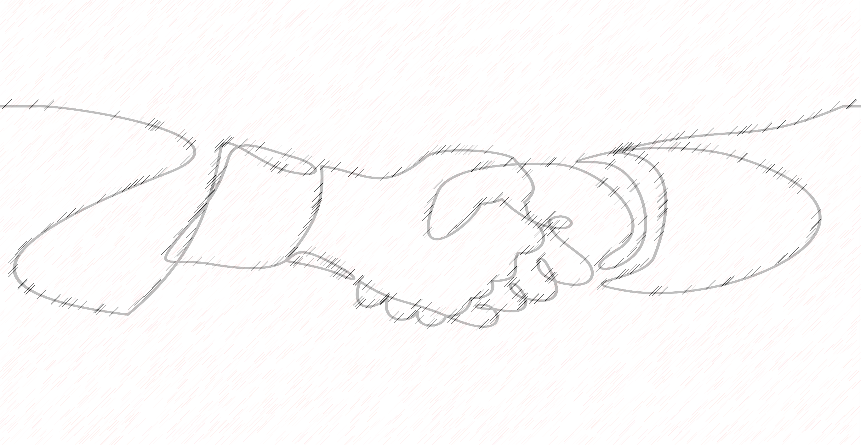
Prepare Weekly Meeting - Define
Purpose Statements
The best company in the state.
A company you can trust.
One company shared with me their whole company was focused on
the commitment to “Kindness.”
The point here is, you want your culture to offer the experience that you’re
up to something bigger than merely making money.

Slide 10

Prepare Weekly Meeting - Define
Mastery
Opportunity to solve problems in weekly meeting.
Ability to be coachable and coach others.
Employees moving beyond their previously thought limits.
Mutual Accountability in support of other team members.
Career development through review process.

Slide 11
Prepare Weekly Meeting - Define
Autonomy of Employees
Work independently and with peers in teams.
Solve problems independently and collectively.
Put together and give their own reports.
Build their own annual department plans with budgets to drive their annual reviews.

Slide 12

Prepare Weekly Meeting - Define
Purpose
Acknowledge what's working.
Celebrate accomplishments.
Plan and commit to future actions.
Solve problems as a team

Slide 13
Prepare Weekly Meeting - Define
Intent
This is where all the previous work comes TOGETHER in reports that give us a view into each person’s world of accountability, quickly and simply.
What EMPOWERS someone is what they say, not what you say.
What gets measured is what gets done.....PERFORMANCE MEASURED is performance improved.
If you want to see what someone is committed to, LOOK at their RESULTS.

Slide 14
Prepare Weekly Meeting - Misunderstandings
There is no REAL accountability WITHOUT reporting.
You can’t have POWERFUL reporting WITHOUT metrics.
You can’t have EITHER without a weekly meeting forum for your teams to come together in.

Slide 15
Prepare Weekly Meeting - Breakthrough
Purpose
The whole point to the game here is TRANSPARENCY.
The ability to stop working in the business, and work ON the business.
To take a moment in the week where we check in to see what the score is, what’s working, what’s not working so well, solve those problems, and make some important plans and commitments to MOVE forward.

Slide 16
Prepare Weekly Meeting - Breakthroughs
Intent
Bring KEY players on the team together in a weekly meeting allowing each person to say what they accomplished in terms of agreed upon metrics.
That seriously drives improvement for the BEST ways to measure each
of their successes, INSIDE each of their accountabilities.

Slide 17
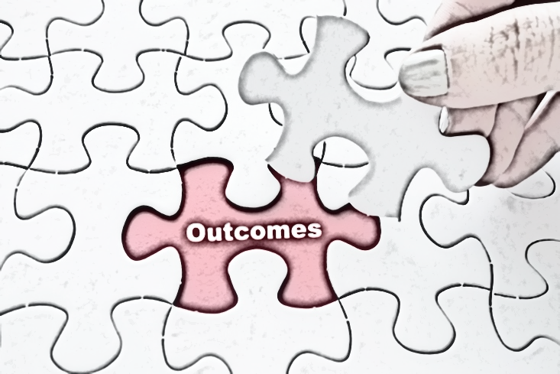
Prepare Weekly Meeting - Breakthroughs
Outcomes
Please, not the story of what they did all week, just the FACTS of whether
they hit their metrics or not.
The focus is on STATISTICS, rather than narrative and story-telling about everything they did that week.
They also REPORT on any problems or breakdowns they had, solutions,
and their action promises for the coming week.

Slide 18
Prepare Weekly Meeting - Breakthroughs
Outcomes
When this comes together in a 1-hour meeting, it:
Delivers a lot of important FACTS and information quickly and easily;
Gives you easy to see focused summary form of RESULTS only,
Which gives you Transparency, and, Empowers each person speaking in their ACCOUNTABILITY OWNERSHIP and PROBLEM-SOLVING SKILLS.

Slide 19
Weekly Meeting Advantages

Slide 20
7 Steps to Power Academy
Weekly Meeting Advantages
Advantage #1: Your Consolidation of Power
Offers the opportunity to track important results weekly.
Supports to create an environment of continuous learning.
Builds team, Ownership, and Mutual Accountability.
Creates transparency and visibility of results.
Drives issues, problems, and challenges to the table.
Teams learn to solve their own problems with peers.

Slide 21
7 Steps to Power Academy
Weekly Meeting Advantages
Advantage #2: Building Your Power Base
An environment of continuous learning with peers.
Freedom and Ownership, to be fully responsible and fully accountable.
This full responsibility coupled with weekly repetition of solving problems sharpens problem solving skills.

Slide 22
7 Steps to Power Academy
Weekly Meeting Advantages
Advantage #3: Building Lasting Ownership & Leadership
Weekly repetition trains participants in seeing business from the whole perspective as an owner sees it.
That training builds their leadership skills.
This can provide the foundation for a succession or exit strategy.

Slide 23
7 Steps to Power Academy
Weekly Meeting Advantages
Advantage #4: Keep it Alive, Keep it Moving
The meeting should be no more than one hour.
No story, just the facts. Or else you successfully achieve the phenomena commonly known as “death by meeting.”
Each weekly meeting continuously adds focus and challenge to team's performance.

Slide 24
7 Steps to Power Academy
Weekly Meeting Advantages
Advantage #5: An Environment of Continuous Learning
Without continuous learning your business plateaus.
Continuous learning supports business growth and continued profitability, which supports career pathways for key employees, which supports their motivation and best efforts, which gives you a highly productive work force, which again, gives you business success and profitability.

Slide 25
Create An Environment of Continuous Improvement

Slide 26
Prepare Weekly Meeting - Breakthroughs
Apathy, resignation, laziness and reasonableness are replaced with
Transparency, Focus and Accomplishments.
As each person sees how they can contribute to the whole team winning.

Slide 27
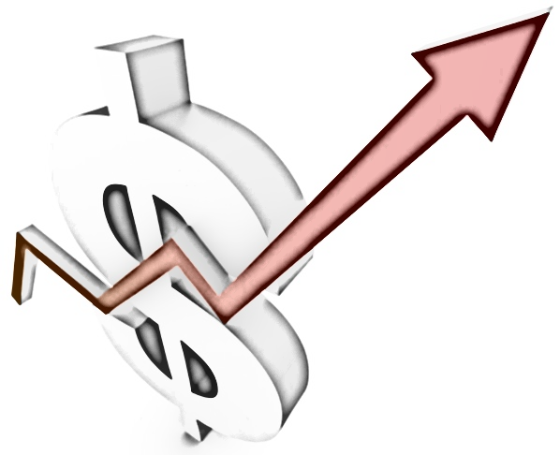
Prepare Weekly Meeting - Breakthroughs
Bottom Line Results
Each person has the opportunity to speak up for what drives their own success.
Reporting makes everything important completely visible.
Reporting to peers drives problem solving with peers.
Peer to peer problem solving drives ownership and accountability for whole team.

Slide 28
Prepare Weekly Meeting - Breakthroughs
Bottom Line Results
Teams become the DRIVING force of daily operations.
PRODUCTIVITY goes up.
And PROFITS follow.

Slide 29
7 Steps to Power Academy
Prepare Weekly Meeting - Breakthroughs
The combination of Mastery, Autonomy, and Purpose
in any business is extremely
POWERFUL, PRODUCTIVE, and PROFITABLE.
This comes together in your Weekly Meeting.
To give you Breakthrough Level Results.

Slide 30
7 Steps to Power Academy
Prepare Weekly Meeting Agenda
Review

Slide 31
7 Steps to Power Academy
Key Points
1
A well-designed meeting structure allows for a large amount of important information to be exchanged in a short period of time.
2
Everyone can see each other’s job performance. Transparency!
3
The team handles problems and generates their own solutions.
4
When the teams handle their own problems and solutions, the solutions being generated stick.

Slide 32
7 Steps to Power Academy
Key Points
5
7 points that will give us a breakthrough mtg, and running an awesome mtg will support us in having a highly productive week.
weekly mtg is a reflection of the entire week. The micro of the macro
As the mtg goes, so goes the week,
I trust you will see how having our attention on these 7 points will contribute to empowering our whole team in driving for the results we need to have a great week.
Velocity –the speed of delivery, level of engagement, and time spent giving the report, keep it moving
Accuracy – have the numbers be accurate, layout of the report itself, does it have everything we need to see
Efficiency – have the reports teed up before so we have no downtime waiting between people
Volume – speaking up creates energy, wakes people up, the more we wake it up the more energy we all have ( it doesn’t cost anything)
Usefulness – are we looking at the best info, is there anything we don’t see that we need to, what we measure is what drives our attention and results?
Problem / Solutions Speed – have the reports show and demonstrate we are taking new ground; how fast can we solve problems?
Breakthroughs – this is a significant measure of your leadership, your ability to coach, support, and empower each of your co-workers.
6
7

Slide 33
7 Steps to Power Academy
Key Points
5
Team structure is self managing and self generating.
6
Team structure creates a learning environment of continuous improvement.
7
Culture of continuous improvement and learning creates profitability.

Slide 34
7 Steps to Power Academy
Process Milestones
Create distinct sections of reporting – what worked, didn’t work, breakdowns, solutions, and acknowledgements.
1
2
Report on facts, no story – watch the time for each report.
3
Have promises for important daily/weekly actions made during reports.
Acknowledge breakdowns being resolved by team when seen as the pathway to continuous improvement.
4
5
Mutual accountability, when individuals become accountable for each other.

Slide 35
7 Steps to Power Academy
Breakdowns
1
Not listening to what people are saying sends the not important message.
Drift towards not reporting important metrics, or not reporting on all of them.
2
3
Unclear reporting of work “in progress” (it’s either done or not).
4
Not holding everyone to the same standards and practices.
5
Letting the meeting runs over 90 minutes.
6
Taking calls or texting during the meeting.

Slide 36
7 Steps to Power Academy
Breakthroughs
1
Weekly meeting supports accountability, ownership, and productivity.
2
Meeting agenda empowers a sense of purpose, mastery, and autonomy.
3
Weekly meeting forum sustains continuous improvement through team problem solving.
4
Teams become the driving force of the business.
5
The business is significantly profitable

Slide 37

7 Steps to Power Academy
Virtual Coaching Session Preparation
Do Your Meetings Have:
Transparency? Can you see everything that is important?
Are there any breakdowns anywhere in the company that DO NOT
show up in the meeting through the reports?
Is productivity increasing?

Slide 38
7 Steps to Power Academy
Virtual Coaching Session Preparation
Do your teams feel empowered and acknowledged?
Are you seeing an up stat in ownership, leadership?
Are your teams achieving breakthroughs?
Is the meeting working? Metrics? Agenda? Flow? Timing?

Slide 39

7 Steps to Power Academy
Virtual Coaching Session Preparation
Bring your answers and questions to your next
virtual coaching session.

Slide 40

7 Steps to Power Program
Real Accountability
Thank You

