Slide 1
Real Accountability

Slide 2
Agenda
1
Define Accountability
2
Design Metrics
3
Construct Reports
4
Prepare Weekly Meeting Agenda

Slide 3
Learning Objectives
Learn the purpose, power, and effectiveness of report design.
Discover the significant importance of weekly reporting.
Use reporting for acknowledgements to support morale and job satisfaction – key for discretionary effort.
Discover how to use reporting to support transparency and why that's critically important for success at all levels.
Learn how effective reporting accelerates performance results.

Slide 4
7 Steps to Power Academy
Key Terms
Transparency – The ability to see the facts easily, simply and quickly.
Reporting – give a spoken or written account of something that one has observed, heard, done, or investigated.
Results – a consequence, effect, or outcome of something.

Slide 5
7 Steps to Power Academy
Construct Reports - Define
REPORT - Definition
A written and verbal account of facts
inside each person's accountabilities.
Just the facts…
Simple, easy, gotta get it in 3 seconds
Otherwise we get into information overload

Slide 6
7 Steps to Power Academy
Construct Reports - Define
Transparency is the Key to Reports
Keep it really VISIBLE, so we can see it fast and easy
No Busy Spreadsheets
Keep it SIMPLE so we get it fast - PROMISE and RESULT
Have 3 months in TIME so we can SEE monthly trends.
When the team can see everything vitally important
they are EMPOWERED to take right actions.

Slide 7
7 Steps to Power Academy
Construct Reports - Define
Everyone's a leader
Great Reporting not only presents up to date, factual, accurate information,
It also uses historical, current, and trending facts to empower the whole team to see exactly where they are today, will be tomorrow, plan, solve problems,
and
DRIVE towards SUCCESS

Slide 8
7 Steps to Power Academy
Construct Reports - Misunderstandings
Everyone's a leader…
Reporting is one of the simple things; so easy and so capable of making
a HUGE difference, IF you use it correctly.
Keep in mind….putting a massive amount of information on a page,
Can create information overload and put people to sleep.

Slide 9
7 Steps to Power Academy
Construct Reports - Misunderstandings
Everyone makes a difference…
Whether it be management of others, any leadership position,
or any position that PREPARES a report.
Each person can present information in a way that actually contributes to
the whole company’s growth and PROFITABILTY.
That is right…every person can actually make a difference in contributing to the WHOLE company.

Slide 10
Construct Reports - Breakdowns
Our Challenge…
The MISTAKE really good employees make is in thinking that their job
is just this one little part, and not connected nor impacting every
single person in the COMPANY.
The truth is, we’re all in this together, every single person makes a difference, and LEADERSHIP can happen from ANYONE
and ANYWHERE.

Slide 11
Construct Reports - Breakthroughs
Our reporting tools are one simple, fast, easy way to make a
HUGE difference that hold all employees accountable to themselves and drives us all to SUCCESS.
Let's take a look and see what this could look like…

Slide 12
7 Steps to Power Academy
Construct Reports - Breakthroughs
Real Power lives in their Speaking
Give ‘em a VOICE and a seat at the table.
And you give them POWER to do their job.
Reporting adds ACCELERATION to Performance.
It brings FOCUS to each ACCOUNTABILITY.
The act of reporting increases RETENTION and learning.
It seriously EMPOWERS team and peer participation.

Slide 13
7 Steps to Power Academy
Reconstruction Production Report Samples

Slide 14
7 Steps to Power Academy
Construct Reports
General Manager/Branch Manager Financial Report
 | Goal | March | February | January
Leads | 80 | $16.00 | 109 | 120
Estimates $ | 2.2M | $451,943.27 | $1,609,118.09 | $3,307,993.70
Pipeline $ | 2.2M | $1,721,627.63 | $2,693,234.48 | $2,528,341.76
Sales $ | 1.1M | $260,061.41 | $1,089,292.60 | $1,086,494.38
WIP $ | 4.4M | $3,142,897.00 | $3,113,185.04 | $3,096,874.89
Invoiced $ | 1.1M | $416,937.88 | $1,205,832.02 | $1,037,980.93
Closed $ | 1.1M | $283,981.28 | $498,107.10 | $251,370.21
GP% | 55.00% | $0.57 | 61.84% | 67.43%
Collected $ | 1.1M | $429,188.56 | $918,067.92 | $797,592.47
Collection cycle in days | 15 Days | $14.82 | 14.83 | 14.91
STR POMS | 4 | $3.45 | 2.64 | 4.38
EMS POMS | 4 | $4.67 | 4.25 | 4.67
A/R Balance $ | 250K or less | $587,874.91 | $547,360.71 | $580,942.31
Rev To Be Invoiced BEM |  | $683,062.12 | $652,879.45 | $250,000.00
2018-19 Sales Goal | $ 14,000,000 | $1,166,666.00 | $1,166,666.00 | $1,166,666.00
2018-2019 Sales Total | $ 2,660,751 | $416,937.88 | $1,205,832.02 | $1,037,980.93

Slide 15
7 Steps to Power Academy
Construct Reports Project Manager
 |  |  | McPike 2018 - GP & Revenue Goals
Measurable: | Goal | NOV MTD | OCT MTD | SEPT MTD | AUG MTD | JUL MTD | JUN MTD | MAY MTD
GP | 58.00% | 59.00% | 61.00% | 59.00% | 61.00% | 51.00% | 52.00% | 58.00%
Act. Rev. closed MTD | 300,000.00 | 53,787.06 | 247,656.39 | 199,277.77 | 2,279.31 | 144,550.04 | 202,014.16 | 152,304.78
Projected closing MTD |  | 330,876.02 |  |  |  |  | 0
Total WIP (Unpaid) |  | 744,403.53 |  |  |  |  | 0
Survey Scores | 100.00 | 100.00 |  | 97.00 | 100.00 | 98.00 | N/A | 97.00
NOV | McPike | Reed | Culver, Ray STR | 48,289.23 | 48,289.23 | 0.00 | 9,914.71 | 59%
NOV | McPike | Sullivan | Brown, Jay STR | 95,442.44 | 25,442.44 | 3,429.60 | 3,409.19 | 93%
NOV |  | Maina | Carden, Adam STR | 35,134.62 | 34,134.62 | 723.24 | 5,900.10 | 61%
NOV | McPike | Jameson | Mills, Cathy STR | 47,814.30 | 47,814.30 | 0.00 | 11,940.47 | 50%
NOV | McPike | Sullivan | Simpson, Harry STR | 34,940.95 | 34,940.95 | 317.58 | 4,813.44 | 85%
NOV | McPike | Daniels | McPike | 15,467.42 | 15,467.42 | 1,909.13 | 4,175.02 | 61%
DEC | McPike | Jameson | Donaldson, Tom STR | 27,000.15 | 26,500.15 | 830.00 | 10,087.90 | 60%
DEC | McPike | Sullivan | Nelson, Willie STR | 120,938.64 | 73,107.69 | 15,473.31 | 20,659.72 | 70%
DEC | McPike | Daniels | Klein, Nathan STR | 95,578.11 | 14,336.72 | 1,917.92 | 27,856.53 | 69%

Slide 16
7 Steps to Power Academy
Construct Reports Project Manager Team Comparison
 | OMAHA Project Managers
 | WIP | # of projects | JUN complete | JUN Target | JUL Target | Balance Remaining
 |  |  |  | Complete | Complete | Completed
Adams | $ 680,672 | 23 | $ 34,150 | $ 162,685 | $ 64,505 | $ 6,794
Baker | $ 530,779 | 30 | $ 11,073 | $ 136,749 | $ 124,297 | $ 14,291
Camden | $ 814,150 | 20 | - | $ 437,671 | $ 149,422 | $ 55,257
Davis | $ 762,125 | 21 | $ 47,285 | $ 97,445 | $ 254,511 | $ 37,651
Sum | $ 2,787,726 | 94 | $ 92,602 | $ 834,550 | $ 592,735 | $ 706,728
 | LINCOLN Project Managers
 | WIP | # of projects | JUN complete | JUN Target | JUL Target | Balance Remaining
 |  |  |  | Complete | Complete | Completed
Edwards | $ 538,228 | 7 | - | $ 287,701 | $ 157,478 | $ 34,332
Fox | $ 383,442 | 12 | - | $ 109,643 | $ 132,405 | $ 2,684
Goethe | $ 390,696 | 6 | $ 68,593 | $ 145,136 | - | $ 17,251
Harley-Davidson | $ 22,306 | 4 | - |  | $ 18,199 | -
Sum | $ 1,334,674 | $ 29 | $ 68,593 | $ 542,480 | $ 308,082 | $ 54,267
TOTAL | $ 4,829,128 | $ 144 | $ 161,198 | $ 1,377,030 | $ 900,817 | $ 760,995

Slide 17
7 Steps to Power Academy
Construct Reports Project Manager
PM Estimator team
 | August 2015 | September 2015 | October 2015 | YTD/Previous Week
Sales/Goal Should Be @ / Variance | $502,960/$422,500 $422,500 / $80,460 | $345,303/$422,500 $422,500 /-$77,197 | $343,930/$422,500 $422,500 /-$78,570 | $4,134,723/$5,070,000 $3,802.500/ +$332,223
Closed/Goal Should Be @ / Variance Gross Margin | $718,172/$422,500 $422,500 / $295,672 42% GM | $415,212/$422,500 $422,500 / -$7,288 45.38% GM | $426,656/$422,500 $422,500 / +$4,156 42.82% GM | $3,817,186/$5,070,000 $3,802,500/ +$14,686 43.38%GM July Total
Aged Receivables >30 Days >90 Days >120 Days | $123,674 $66,461 $0 $57,212 | $231,457 $203,667 $0 $27,789 | $217,450 $133,295 $62,635 $21,519 | $206,439 $122,284 $62,635 $21,519
Production Closed % Aged Receivables of PC | $1,004,688 %12 | $786,826 %29 | $419,840 - %51 | $355,895 %58
Pipeline | $1,318,803 | $1,073,248 | $1,083,662 | $1,181,273
Total New Losses/Goal $ Amount Written Cancel % *** | 35/50 $209,531 | 53/50 $523,858 | 75/50 $340,844 | 778/600 $5,768,042 18.7% Lost 1.08 mil
Marketing Contacts Actual / Weekly Goal |  | (2 RF, 9 FF) 1 JE, 1 USAA | (5 RF, 9 FF) 2 NW, 4 USAA (2 Patti Barber, 1 Chalice, 2 Tim Yates) | (5 RF, 6 FF) 2 NW, 4 USAA (2 Patti Barber, 2 Tim Yates, 1 Latisha Josiah)
Projections: Notes: | Pipeline: Antione: 264k - 48 Harris: 124k - 15 Stephen: 694k - 43 Sales: Antione: 200k Harris: 91k Stephen: 283k October Total: $574k Closings: Antione: 186k Harris: 2k Stephen: 313k October Total: $501k Diversification of Losses: Antione #44, Harris #13 and Stephen #18 September Behind $317,537
May 24, 2021

Slide 18
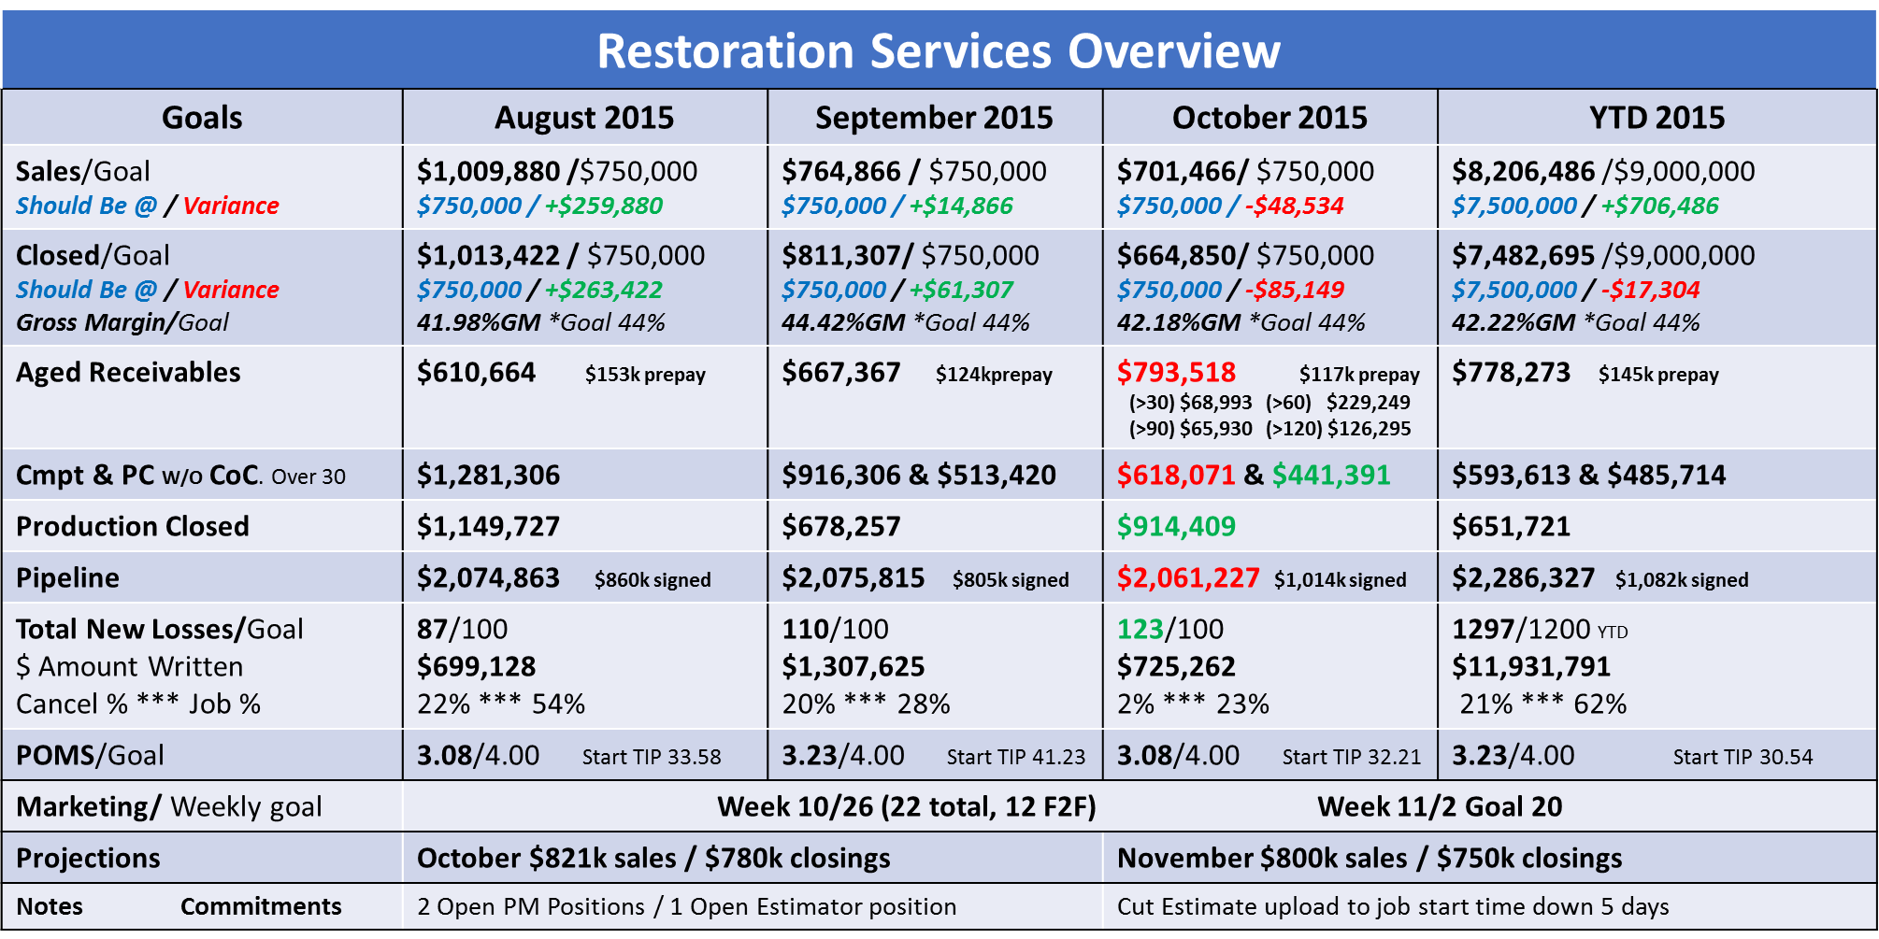
7 Steps to Power Academy
Construct Reports Project Manager
May 24, 2021

Slide 19
Construct Reports Project Manager
Production Team Overview for 2 Locations
 |  |  | ST. HELENA
 | WIP | # of Projects | FEB Complete | FEB Target Complete | MAR Target Complete | Balance Rem. Completed
Meyer | $1,050,498.00 | 15 | $30,314.00 | $471,733.00 | $202,297.00 | $31,360.00
Jackson | $848,817.00 | 26 | $20,474.00 | $246,911.00 | $328,060.00 | $44,356.00
Reynolds | $554,364.00 | 21 | $255,369.00 |  | $337,929.00 | $40,444.00
Glass | $496,626.00 | 25 |  | $109,167.00 | $60,886.00 | $18,104.00
Sum | $2,950,305.00 | 87 | $306,157.00 | $827,811.00 | $929,172.00 | $134,264.00
 |  |  | PORTLAND
 | WIP | # of Projects | FEB Complete | FEB Target Complete | MAR Target Complete | Balance Rem. Completed
Riggs | $760,137.00 | 12 | $5,024.00 | $280,150.00 | $283,824.00 | $2,907.00
Swanson | $528,540.00 | 9 | $2,143.00 | $49,389.00 | $273,532.00 | $5,034.00
Brisco | $522,939.00 | 13 |  | $5,217.00 | $421,514.00 | $10,722.00
Williams | $176,071.00 | 9 | $18,199.00 |  | $63,158.00 | $5,146.00
Sum | $1,987,687.00 | 43 | $25,365.00 | $334,756.00 | $1,042,029.00 | $23,809.00
Note: Ratio of WIP to number of projects to actual completion and target completion

Slide 20
7 Steps to Power Academy
Construct Reports Produced GP$
 |  | APRIL
JOB # | REVENUE TYPE | NAME | LOCATION | REVENUE | GP % | ACTUAL GP
301 | Construction | Hunt | Bridgewater | $31,247.00 | 44 | $13,748.68
302 | Mitigation | Martin-Costa | Somerset | $6,550.00 | 62 | $4,061.00
303 | Construction | Ferry | Fall River | $31,050.00 | 43 | $13,351.50
304 | Construction | Amirault | Acton | $39,193.00 | 45 | $17,636.85
305 | Construction | Humphreys | S Easton | $21,583.00 | 39 | $8,417.37
306 | Construction | Barret | Norfolk | $100,000.00 | 41 | $41,000.00
307 | Construction | Anton | New Bedford | $109,113.00 | 44 | $48,009.72
308 | Construction | Woodward | Brockton | $127,493.00 | 46 | $58,646.78
309 | Mitigation | Chestnut | Chestnut | $583.00 | 66 | $384.78
310 | Contents | Hill | Stoughton | $8,826.00 | 73 | $6,442.98
311 | Contents | Godwin | Rockland | $18,157.00 | 70 | $12,709.90
312 | Construction | Cusack | Brockton | $47,463.00 | 38 | $18,035.94
313 | Mitigation | Lamont | Duxbury | $18,067.00 | 67 | $12,104.89
314 | Mitigation | Feinberg | Foxboro | $8,693.00 | 66 | $5,737.38
315 | Construction | Schwandt | Kingston | $21,129.00 | 39 | $8,240.31
316 | Contents | Cryer | E Bridgewater | $2,750.00 | 74 | $2,035.00
317 | Contents | Mossman | Stoughton | $2,647.00 | 68 | $1,799.96

Slide 21
7 Steps to Power Academy
Emergency Service/ Contents Report Samples

Slide 22
7 Steps to Power Academy
Construct Reports EMS Contents
EMS Contents | Goal Per Month/Annual | YTD Avg Per Month | YTD Total | September 2015 | October 2015
Sales - Contents | Q4 80,000/ $240,000 | $63,261 | $649,910 | $64,437 | $80,561
Closed - Contents | $54,200/ $650,000 | $23,235 | $287,085 | $33,976 | $73,135
GM% | 50% |  | 56.07% | 61.87% | 61.69%
Total New Losses | 8 | 9 | 94 | 9 | 14
EMS Contents | September 2015 |  | October 2015
Aged Receivables | $24,921 | 0-60 $17,445 60> $5,517 90> $1,959 | $10,873 | 0-60 $9,586 60> $0 90> $1,287
 | October 2015
Overtime | Week Ending 10/2 10/9 10/16 10/23 10/30 | 6 15 8.5 4 | Total Overtime Hours 33.5
Temp Labor | Week Ending 10/2 10/9 10/16 10/23 10/30 | 59.5 193 268.25 241.5 | Total Temp Labor Hours/$ Hours 762.25 $13,720.50
October Forecast
Vault Count
Sales | $80k
Closing | $75k
Filled Vaults | 130
Filled Shelves | 15
Total Filled | 145
Total Empty (built) /(not built) | 30
Total Vaults | 180

Slide 23
7 Steps to Power Academy
Construct Reports EMS Weekly Summary
EMS Quick View | Goal Per Month/Annual | YTD Avg Per Month | YTD Total | September 2015 | October 2015
Sales – Total EMS | $348,755/ $4,180,649 | $368,411 | $3,674,964 | $305,373 | $359,268
Closed – Total EMS | $348,755/ $4,180,649 | $292,095 | $2,970,791 | $328,169 | $332,863
GM% | 63% |  | 69.52% | 64.98% | 69.41%
Total New Losses | 75 | 105 | 1065 | 94 | 121
 | September 2015 |  |  | October 2015
Monthly Utilization | Week Ending 9/4 9/11 9/18 9/25 | 84% 83% 79% 72% | Monthly Average 79% | Week Ending 10/2 10/9 10/16 10/23 10/30 | 80% 80% 81% 71% | Monthly Average 78%
Overtime | Week Ending 9/4 9/11 9/18 9/25 | 42 40.5 102.5 70.5 | Total Overtime Hours 255.5 | Week Ending 10/2 10/9 10/16 10/23 10/30 | 75 105.5 67.5 82.5 | Total Overtime Hours 330.5
Temp Labor | Week Ending 9/4 9/11 9/18 9/25 | 683.5 784.5 891.25 577.5 | Total Temp Labor Hours/$ Hours 2,936.75 $52,861.50 | Week Ending 10/2 10/9 10/16 10/23 10/30 | 597 434 721.75 601 | Total Temp Labor Hours/$ Hours 2,353.75 $42,367.50
POM Score Average | Annual 4.25 |  | Month 4.14 | Annual 4.25 |  | Month 4.50
October Forecast
Marketing Activities
Sales | $370k
Closing | $395k
Mitigation | Goal / 10 F2F / 10 | Achieved / 2 F2F / 2
Specialty | Goal /15 F2F / 15 | Achieved / 17 F2F / 17

Slide 24
7 Steps to Power Academy
Coordinator Report Samples

Slide 25
7 Steps to Power Academy
Construct Reports
Coordinator Report showing Estimating Team Comparisons
Out of Compliance Report Goal <20 |  |  |  | Difference
December | 5 | 18 |  | -13
IF YOU SCOPE IT… THEY WILL PAY
Estimator | Received | Scoped | Pending/$$ | Sales/SS
Chris | 9 | 7 | 13/est $102,121.77 | 6/est$ 105,858.19
 | Called: 1 | Inspected: 7 | Written: 12 | Need WA: 0
 | Booked: 3 | Written: 0 | Need WA: 7 | Insurance: 1
 | Inspected: 5 | Tot Missing Est: | Need Approval: 11 | Self-Pay: 5
Tyler | 9 | 2 | 15/est $209,246.33 | 6/est$ 82,614.06
 | Called: 0 | Inspected: 2 | Written: 15 | Need WA: 0
 | Booked: 1 | Written: 0 | Need WA: 11 | Insurance: 6
 | Inspected: 8 | Tot Missing Est: | Need Approval: 14 | Self-Pay: 0
David
Adam | 9 | 7 | 6/est $126,493.08 | 9/est $126,493.08
 | Called: 0 | Inspected: 6 | Written: 6 | Need WA: 5
 | Booked: 1 | Written: 0 | Need WA: 5 | Insurance: 2
 | Inspected: 8 | Tot Missing Est: | Need Approval: 6 | Self-Pay: 7

Slide 26
7 Steps to Power Academy
Construct Reports Coordinator Report
BE A PRODUCER |  |  |  | POMS PRODUCTION AND EMS
P.M. | Sales/$$ | Total WIP/$$ |  | PRODUCTION | GOAL | MTD | PM | 12 MONTH
Jason | 4/est $26,563.68 | 9/$121,230.33 |  | Contacted | <2 hrs |  |  | 5
 |  | Est Tot: $342,777.74 |  | Inspected | <24 hrs |  |  | 3
Daniel | 5 pending | 4/1500.00 |  | Estimate Uploaded | <3 days |  |  | 2
 |  | Est Tot: $25,593.56 |  | Job Started | <10 days |  |  | 1
Preston | 1/est $9,197.72 | 20/$13,122.43 |  | Job <10k | <23 Days | 1 |  | 1
 |  | Est Tot: $65,708.91 |  | Job >10k | <43 Days | 4 |  | 3
Carrie | 3/est $62,083.57 | 15/$199,839.48 |  | Would Reuse | 10 |  |  | 2
 |  | Est Tot: $454,544.99 |  | Overall Score | 5 | 2.2 |  | 3.11
Paul | 1/est $7,268.24 | 19/$95,292.33
 |  | Est Tot: $303,411.55 |  | EMS | GOAL | MTD | PM | 12 MONTH
Bob | 3/est $ 31,706.51 | 7/$84,569.33 |  | Contacted | Immediate | 5 |  | 5
 |  | Est Tot: $219,177.10 |  | Inspected | <2 hrs | 5 |  | 4
Wesley | 9/ est $178,145.61 | 18/$49,789.76 |  | Estimate Uploaded | <3 days | 1 |  | 2
 |  | Est Tot: $247,185.21 |  | Would Reuse | 10 | 1 |  | 2
 |  |  |  | Overall Score | 5 | 4 |  | 3.5

Slide 27
7 Steps to Power Academy
Marketing/ Customer Service Report Samples

Slide 28
7 Steps to Power Academy
Construct Reports Marketing Overview April 2019
Quarterly Goal:
Contact Distribution – best fit (Agents and adjusters)
Agent Market Segmentation (Trisha)
Adjuster Relationship Commitment (David and Scott and their teams)
Niche Evaluation: Realtor and Home Inspectors (Harris) and Plumbers (Stan)
Coming Up: Focus:
HomeAid Golf Tournament Oct 9th Builders & Outreach
Con-Con Global Day of Service Oct 10th Community Outreach
Agent CE Class – Fire October 15th Agents

Slide 29
7 Steps to Power Academy
Construct Reports Marketing
Classifications
Current A’s = 78 7-day A’s = 10
Current B’s = 27
Current C1’s = 4 * Trending stable
CE Class – Ethics Nov 5
PLRB - Lg Loss Convention David, Burton, Todd Oct 28-30
Long and Foster – Presentation – Harris and Alex
Nov 3rd
Recognition: Alex P for her professionalism
Challenge - Training for Success
Marketing with Intention

Slide 30
7 Steps to Power Academy
Construct Reports

Slide 31
7 Steps to Power Academy
Construct Reports

Slide 32
7 Steps to Power Academy
Construct Reports

Slide 33
7 Steps to Power Academy
Construct Reports
Review

Slide 34
7 Steps to Power Academy
Key Points
1
Make it easy to see, quickly, simply; like Promise and Result.
2
Show Past, Present, Future to see trending – 3 or 4 a month max.
3
Each person participating has their own report.
4
Reports are designed by each person with support of team.
5
Each person populates their own weekly results – no more than 5 minutes each.

Slide 35
7 Steps to Power Academy
Process Milestones
1
Construct a report for each participating person.
2
Have each report be simple, clear, and transparent.
3
Have reports show commitments and results as simply as possible.
If reporting is clear - all breakdowns, issues, and challenges are
clearly visible.
4

Slide 36
7 Steps to Power Academy
Breakdowns
1
Too many meetings or meetings that run for hours = a phenomena we call “Death by Meeting”.
2
Full size spreadsheets or worksheets with a ton of information.
3
Story Telling about every job, customer, problem, etc.
4
Not listening to someone giving their report by multi-tasking

Slide 37
7 Steps to Power Academy
Benefits of Construct Reports
1
Reports keep the entire team precisely up to date on financial facts.
2
Reports show recent history, current facts and future trends.
3
Reports drive issues to the surface allowing for problem solving by the team.
4
Reports offer the opportunity for steering with future planning and commitments.

Slide 38
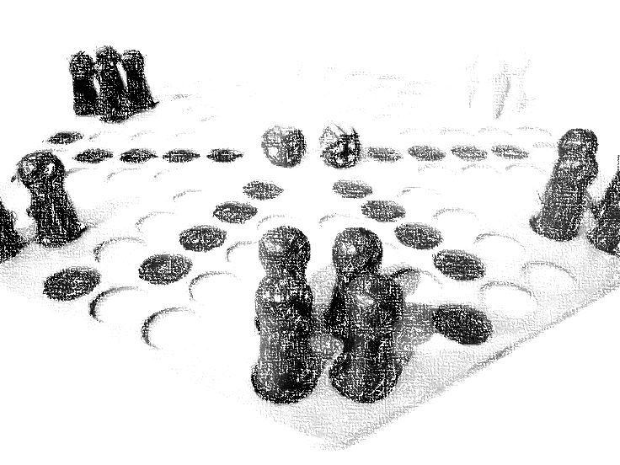
7 Steps to Power Academy
Virtual Coaching Session Preparation
How do you determine who should participate in giving a report?
How do you determine if the reports are effective?
Do your reports give you sufficient transparency?
Can the report be easily seen and delivered in one minute?
Do the reports reveal existing problems and breakdowns?

Slide 39
7 Steps to Power Academy
Virtual Coaching Session Preparation
Bring your answers and questions to your next
virtual coaching session.

Slide 40
7 Steps to Power Program
Real Accountability
Thank You

