Slide 1
7 Steps to Power Program
Real Accountability

Slide 2
7 Steps to Power Academy
Agenda
1
Define Accountability
2
Design Metrics
3
Construct Reports
4
Prepare Weekly Meeting Agenda

Slide 3
7 Steps to Power Academy
Learning Objectives
Have the best driver metrics for every accountability.
Know that metrics may change as the business grows.
Have challenging metrics to support growth for the future.
Have metrics well thought out to support the best possible outcome.
Have metrics that measure every area of the business that has challenges, concerns, or isn’t working as well as you want it to.

Slide 4
7 Steps to Power Academy
Key Terms
KPI’s – Key Performance Indicators
SMART – Specific, Measurable, Achievable, Realistic, and in Time
Metrics – a clearly measurable outcome
Goals – the desired results
Benchmarks – a clearly measurable outcome
Discretionary Effort – the effort given to working of their own free will without anyone pushing or managing

Slide 5
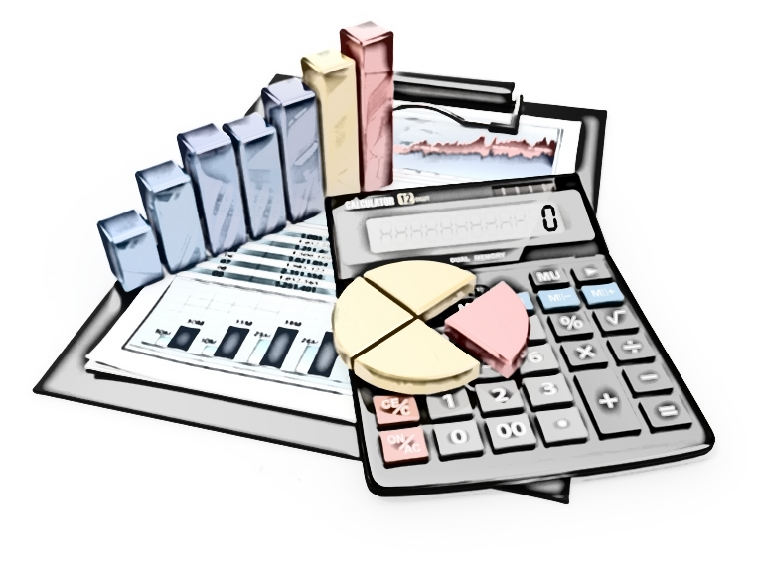
7 Steps to Power Academy
Design Metrics - Define
Metrics...
As the saying goes, “What gets measured is what gets done.”
Or, “If you want to manage it, measure it.”

Slide 6
7 Steps to Power Academy
Design Metrics - Define
Make ‘em Big, So You Have Room for Growth
We think from the outcome, best case results.
Performance measured is performance improved.
Want to have great meetings?
Challenging, exciting metrics become drivers for your success in moving
to the next level and setting up powerful, challenging metrics
keeps people awake…
Great metrics drive performance, continuous improvements, innovation,
and a successful outcome perspective.

Slide 7
7 Steps to Power Academy
Design Metrics - Define
Make ‘em S.M.A.R.T.
Specific
Measurable
Achievable
Realistic
In Time

Slide 8
7 Steps to Power Academy
Design Metrics - Define
Measuring Drives Awareness
In every major sport, there are many statistical measures for
players performance.
Works really well in business too!

Slide 9
7 Steps to Power Academy
Design Metrics - Define
Metrics For Project Managers
Gross Profit Volume Monthly and Year to Date (YTD).
Work In Progress/Volume and number of jobs.
Closed or Invoiced Work Month to Date (MTD).
How much will be closed this month:
At what Gross Profit ($GP) and/or volume?

Slide 10
7 Steps to Power Academy
Design Metrics - Define
Metrics For Project Managers
Gross Profit volume of $150,000 a month
Gross Profit % of 50%
Closing $200,000 to $350,000 a month
Production Team comparisons

Slide 11
7 Steps to Power Academy
Design Metrics - Define
Metrics For Estimators
How much is Estimated Month to Date (MTD)
How much is in Pipeline $
How much is Sold Month to Date (MTD)
Estimator Team comparisons

Slide 12
7 Steps to Power Academy
Design Metrics – Define
Metrics...
Define the OUTCOME needed specifically.
Not the process, not the to-do’s...
just the OUTCOME.

Slide 13
Design Metrics – Define
Ask Yourself the Following…
Is it possible and doable?
Has this ever been done before?
Is it challenging enough to drive success?
Is it too big that it’s not attainable for years?

Slide 14
Design Metrics - Define
It’s Also Important…
To set a METRIC that inspires each person, not suppresses them.
It could be 25%, 50%, or more than previous accomplishments,
The IMPORTANT thing is…
Each person can see themselves accomplishing it,
and are EMPOWERED towards the ACTIONS to do so.

Slide 15
Design Metrics - Define
And…
Measure everything to sync with monthly business financials
Measure by what is accomplished for year to date, and year to year comparisons
TIPs – Time In Process
POMs – Performance Objective Measures

Slide 16
Design Metrics - Breakdowns
Problems with Metrics arise...
When the metrics are too easily attained.
The saying that a fish grows to the size of its bowl applies here
If you have small goals you will only grow so big
When metrics are not reviewed weekly
Metrics need to grow as the company grows
Metrics that are mastered are no longer needed & should be removed

Slide 17
Design Metrics - Breakdowns
More Breakdowns
When you're not measuring for the results you really want
Measuring for results you don't want
Keep updating and refreshing metrics to support continuous improvement, growth and profitability

Slide 18
7 Steps to Power Academy
Design Metrics - Breakthroughs
The Solution: Drive It!
Where the rubber meets the road….that's why we call them DRIVERS.
We are measuring the BEST outcomes for success
inside each person’s accountabilities.
This is the foundation for transparency, focus, and steering.
Because… if you can see it, you can manage it, and…reporting on
best metrics fosters Problem Solving Solution Based Dialogue.

Slide 19
7 Steps to Power Academy
Design Metrics - Breakthroughs
Think About It
It takes some real thinking and looking to create the best intended results and or outcomes for your team, BUT…
It is well worth the time you take to do so…BECAUSE
The right metrics used well is what empowers and inspires employee’s
best discretionary effort – their ability to think for themselves,
their autonomy is a key foundation for breakthroughs in their
PERFORMANCE.

Slide 20
7 Steps to Power Academy
Design Metrics
Review

Slide 21
7 Steps to Power Academy
Key Points
1
Importance of having Goals and Measures at every level of the business
2
Task vs. Outcome orientation
Employees are now more empowered and productive with
steering and focus
3
4
Accentuates the positive direction you’re moving towards

Slide 22
7 Steps to Power Academy
Key Points
5
Have exciting, upbeat, and challenging meetings, use challenging metrics
6
Metrics drive performance, continuous improvements, and innovation
Clarifying the outcome gives significant empowerment to each person’s accountabilities
7
Teams are empowered to give their best efforts, (discretionary effort) take ownership and think for themselves
8
9
Financial metrics turn critical positions into financial Managers

Slide 23
Process Milestones
Have Metrics for each Accountability – look for the intended result if that accountability was being performed successfully
1
2
Make the Metrics challenging, yet achievable and doable
3
Metrics support team's autonomy to plan for actions and deliver results
4
Achieving 80% of Metrics leaves the business at a strong level of success

Slide 24
7 Steps to Power Academy
Breakdowns
1
Measuring the process of work and not the outcomes needed
2
Creating metrics that are too easily attainable suppresses growth
3
Keeping metrics that are no longer needed fosters stagnation
4
Not raising metrics periodically fosters the business to plateau
5
Avoid Benchmarks on the negative side of the goal
6
Owner driving the effort, telling everyone what their benchmarks are

Slide 25
7 Steps to Power Academy
Benefits of Design Metrics
1
Drives results that support breakthrough performance
2
Drives continuous learning and improvement
3
Drives issues, problems, and breakdowns right to the table
4
Focuses team on the most important results for success
Metrics sets the focus for an outcome orientation and supports building ownership and accountability
5

Slide 26
7 Steps to Power Academy
Design Metrics - Breakthroughs
The Benefits of Design Metrics are:
Once people know exactly what the outcomes are,
they can be RESPONSIBLE and ACCOUNTABLE for
whatever it takes to get THERE

Slide 27
7 Steps to Power Academy
Virtual Coaching Session Preparation
Do you have metrics that set up a challenge?
Do you have metrics that keep moving you toward your vision for the future?
Do you have metrics that clearly define success inside each
person’s accountabilities?

Slide 28
7 Steps to Power Academy
Virtual Coaching Session Preparation
Can you use the same metrics forever?
How would you know if you need to invent new metrics?
How do you know if the metrics you’re currently using are working for you?

Slide 29
7 Steps to Power Academy
Virtual Coaching Session Preparation
Do your metrics capture every area that needs attention?
Are there any breakdowns that don’t get addressed by current metrics?
Are your metrics thought out for the best possible and most desirable outcome?
Did you create each of your team’s metrics or did they create their own?

Slide 30
7 Steps to Power Academy
Virtual Coaching Session Preparation
Bring your answers and questions to your next
virtual coaching session.

Slide 31
7 Steps to Power Program
Real Accountability
Thank You

